Slide 1
Round 3
Technical Skills Development
and Employment
Technical Assistance Presentation

Slide 2
About EmployIndy
Mission
Vision
EmployIndy guides the local workforce ecosystem and makes strategic investments to promote equity and remove barriers to quality employment for underserved and underrepresented residents.
For all Marion County residents to have access to services and training necessary to secure a livable wage and grow in a career that meets employer demand for talent.

Slide 3
Labor Market Information
State Unemployment Rate: 3.4% - AA Unemployment Rate: 5%
- as of August 2023 Economic Bureau
High demand industries driving the local economy with non-degree, entry level, industry recognized certifications, offering pathways to good wage jobs:
Construction
Advance Manufacturing
Logistics
Healthcare
Information Technology
Among the occupations that are growing fastest are wind turbine techs, software developers and health care professionals. Those with both high demand and higher wages include managers in construction, medicine and general operations as well as accountants, physicians, electricians and plumbers
Employment Outlook Projections: Hoosiers by The Numbers (in.gov)
Is your training demand supported by good data?

Slide 4
Best Practices for Adult Training
Cohort Based
Career Navigation Assistance
Comprehensive Barrier Buster Support
Earn and Learn Model (micro progressive increases)
Participation/Completion Incentives
Growth Mindsets Transition Experience (Visioning)
Employability Skills Training (Job Readiness)
Socio-emotional Trauma Trained Facilitators
High Wage In-Demand or Interest Driven Occupational Training Pathways:
Construction; Logistics; Adv Manuf; Healthcare; IT; Drones Tech; CDL
Day & Evening Training Hours
Paid Work Based Learning with Employer
Industry/Employer Partners Engagement
Mentoring Support
Follow up Retention Services (360 days)

Slide 5
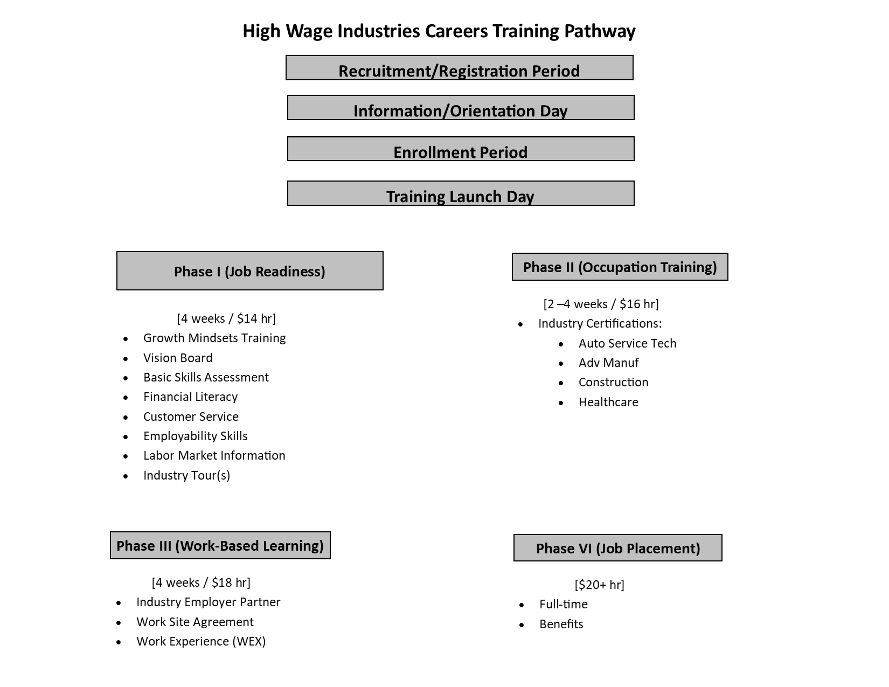
Example of a
Training Model Framework

Slide 6
Questions to Consider:
To what industry or jobs does your occupational training align?
Who are the major employers in that industry valuing your certification?
Which employers are you partnering with to serve their need for talent with your graduates?
Which employers are willing to participate in training talent through offering a paid work experience (WEX) and commitment to hire, if successful?
How are you connecting with employers?
Trainings should be committed to offering successful completers the GUARANTEE of a job!

Slide 7
EmployIndy Can Help w/Job Readiness!
Let us know in the “chat” now
If interested in learning more about connecting
to
Job Ready Indy!

Slide 8
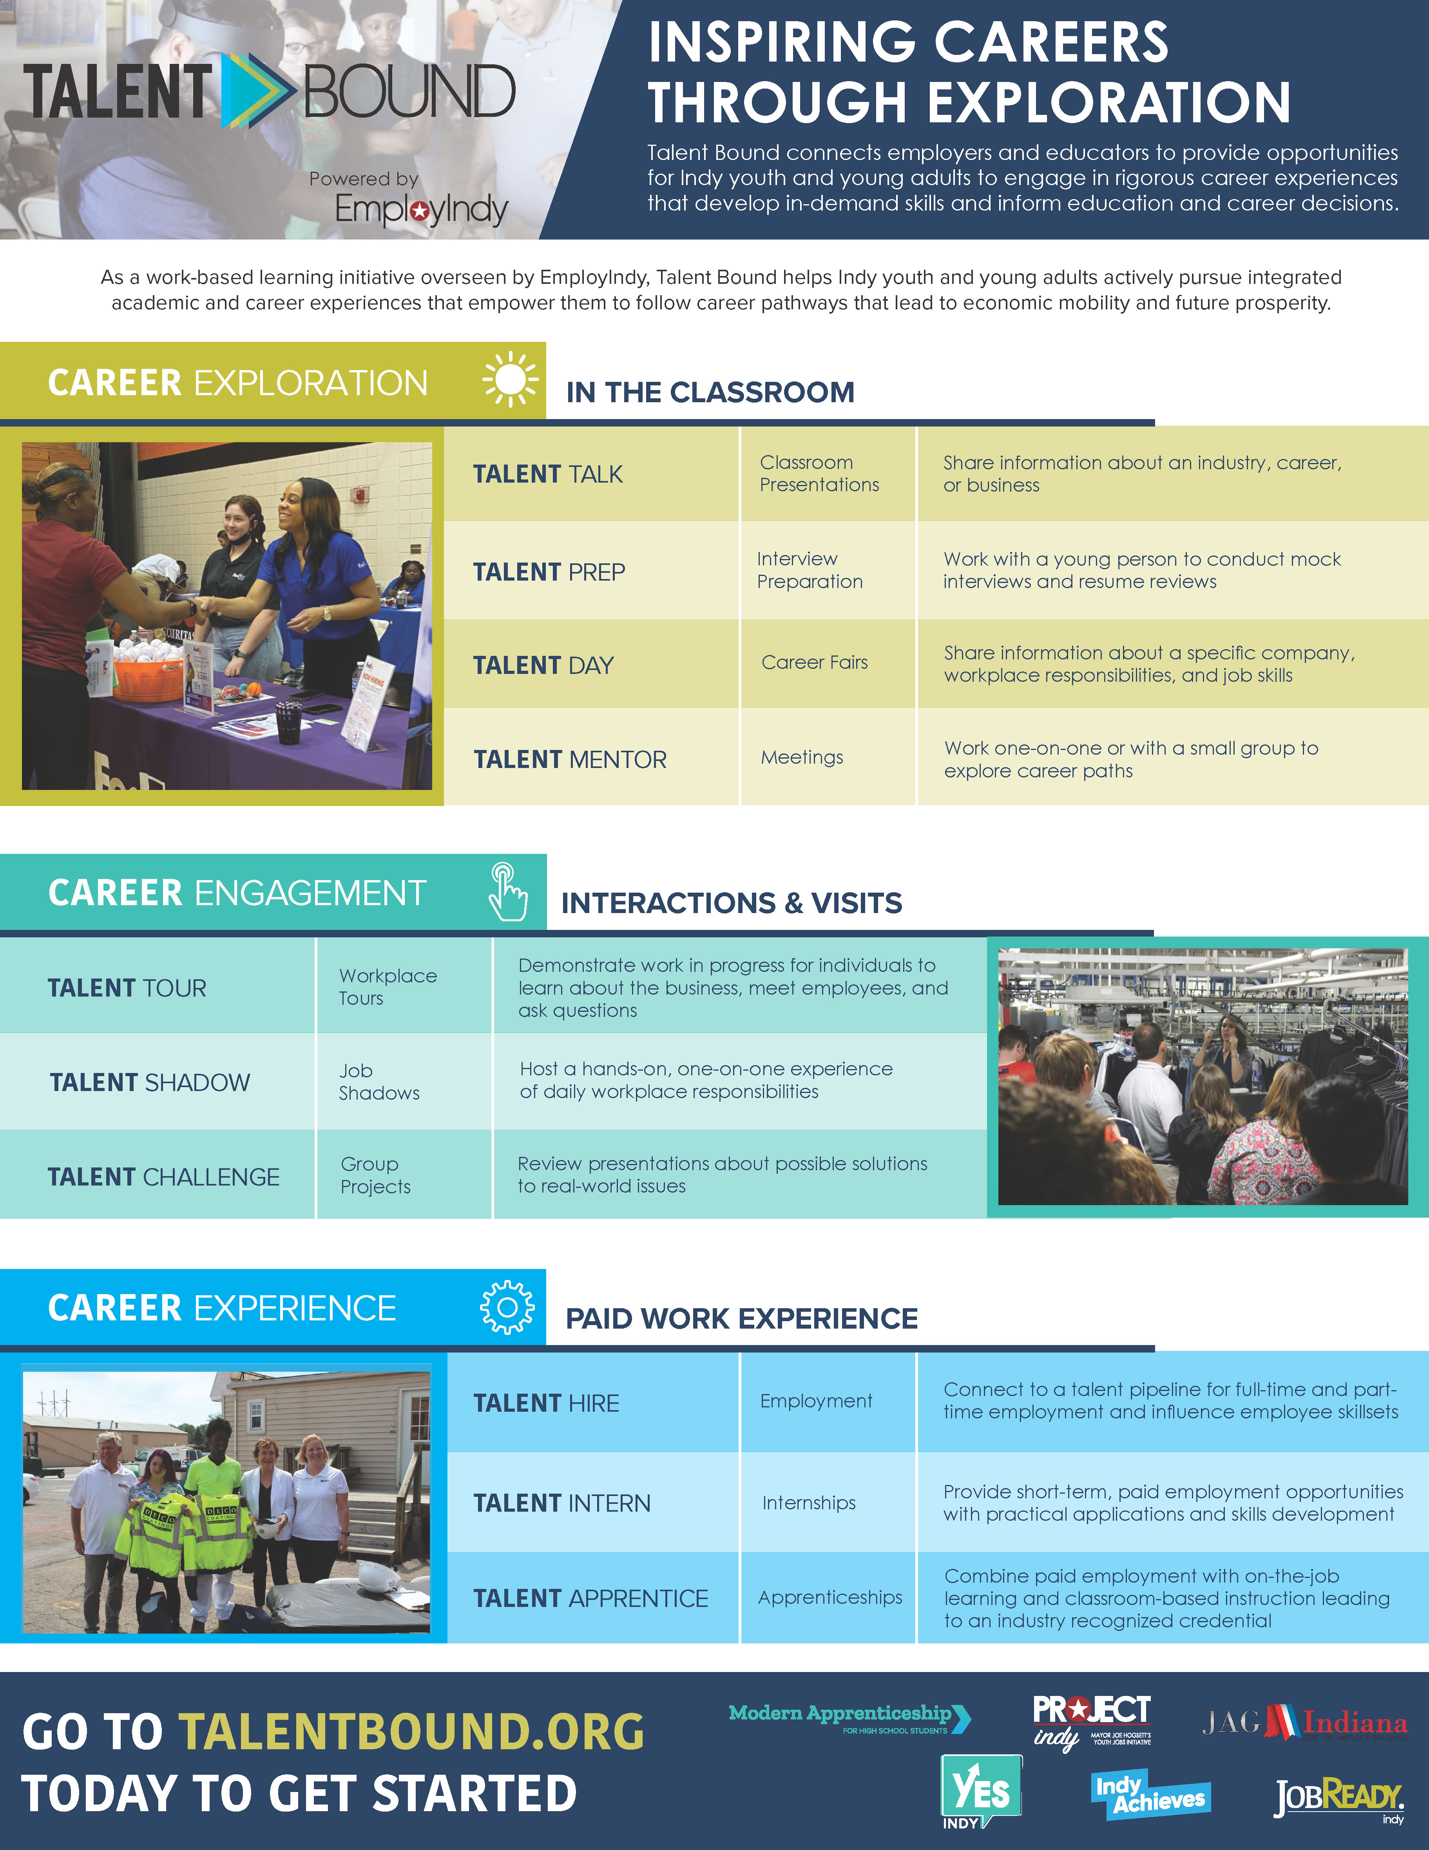
EmployIndy Can Help w/Employer Engagement!
Let us know in the “chat” now
If interested in learning more about connecting
to
Talent Bound!

Slide 9
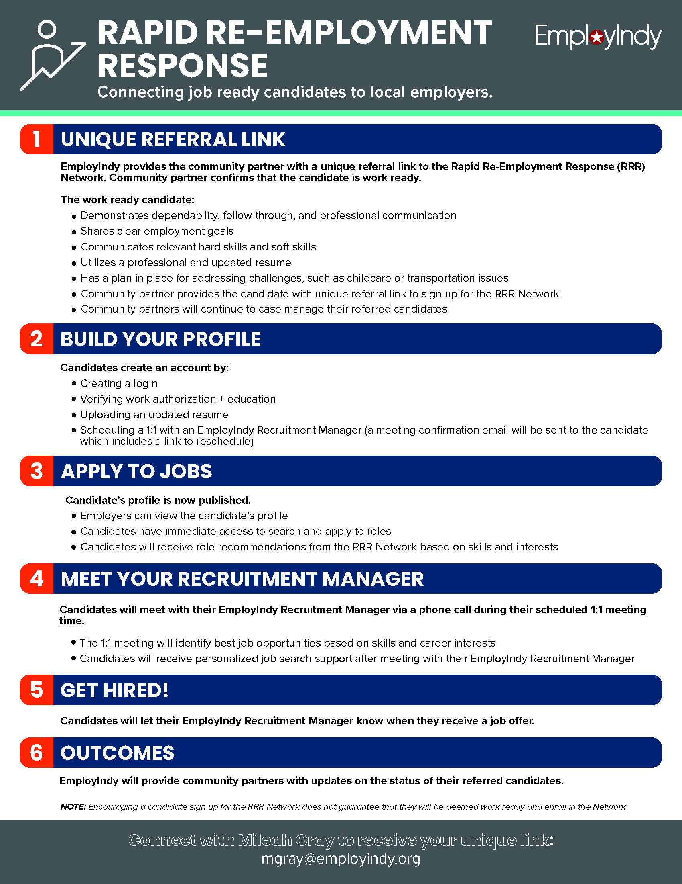
EmployIndy Can Help w/Employer Placements!
Let us know in the “chat” now
If interested in learning more about connecting
to
Rapid Re-Employment / Talent Network!

Slide 10
Key Program Outcomes
# Enrolled in Industry Training Program
# Completed Job Readiness Training
# Completed Industry Training
# Earned Industry Recognized Credential
# Placed in Unsubsidized Employment
# Employed for 30 days
# Employed for 60 days
# Employed for 90 days
Measuring success?

Slide 11
Q&A
Rev. Rodney T. Francis, M.Div.
Executive Vice President, Workforce Services
rfrancis@employindy.org
employindy.org

